Slide 1
Wild Fire (B) Milestone Presentation
Stuart Heeb Johannes Kurz Yitong Xia Yingyan Xu

Slide 2
Milestone Presentation
Reminder of Goals
What do you want to visualize?
Temperatures under burning process.
Bulk density (vegetation density) under burning process.
Wind velocity and vorticity field.
Factors that contribute to Vorticity-driven Lateral Spreading (VLS) behvior of the fire.

Slide 3
Milestone Presentation
Current State
How do you want to visualize things? And what you have/haven‘t achieved?
Volume rendering: fire, soil , vegetation.
Streamline: wind velocity field.
Vorticity field: wind velocity field -> gradient -> wind vorticity field.
Animations: the evolution of fire on the full “backcurve40” dataset (70GB).
Isosurfaces: more precise contours of fire, decided by oxygen level and fire-induced heat.
Quantitative Analysis: on how terrain and vorticity influence the VLS behavior.
Implementation in VTK.
Are you on schedule or behind?
On schedule.

Slide 4
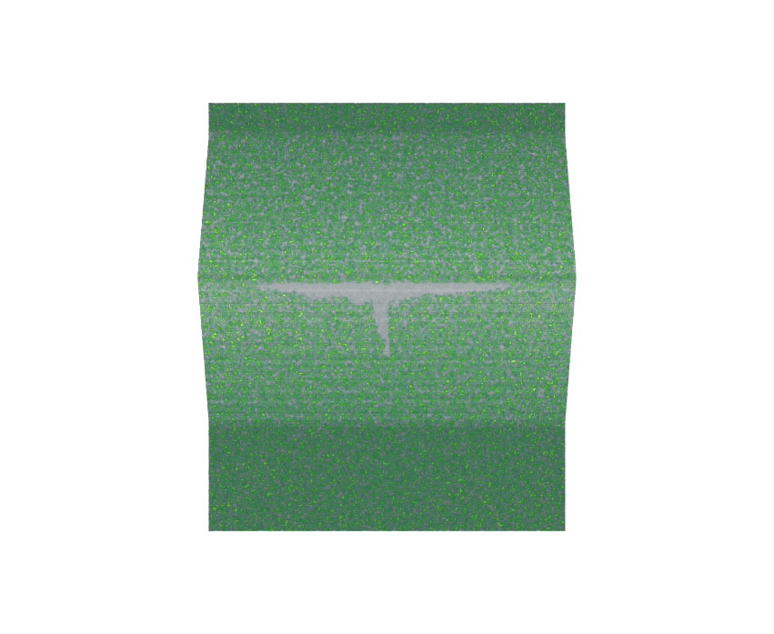
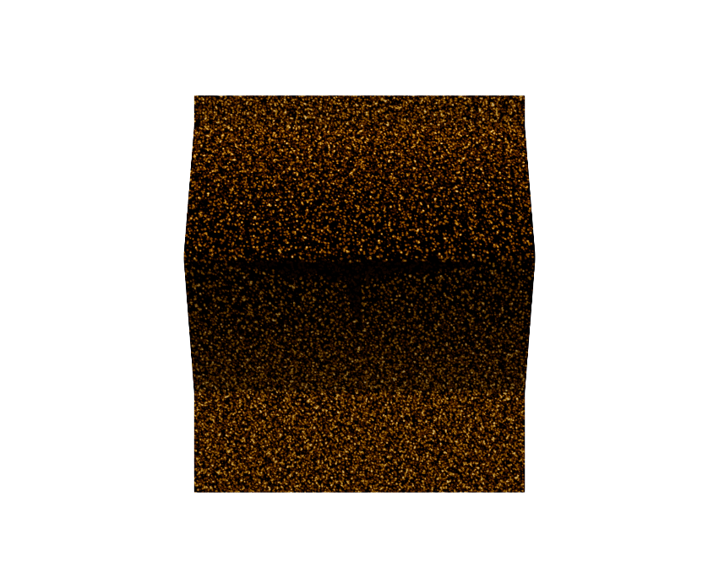
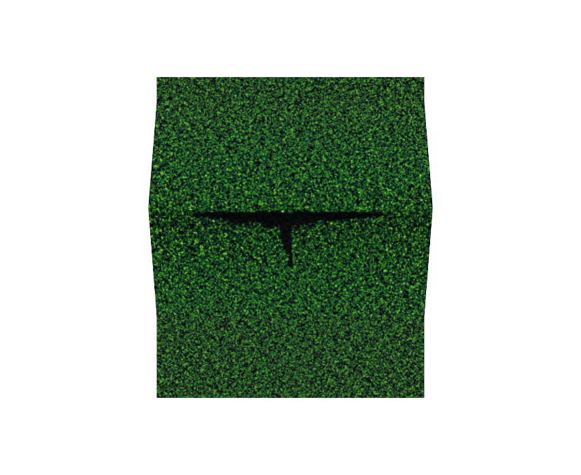
Milestone Presentation
Results
Vegetation, Soil
Takes the bottom few layers of the curvilinear data.
Vegetation: resample to ImageData and use directly volume rendering.
Soil: thinner than vegetation layer and rendered as surface for best visual effects.
Composition: show a more realistic vegetation scene and the trace of fire (disappeared vegetation and scorched land) after burning.
+
=
Vegetation
Soil
Composition

Slide 5
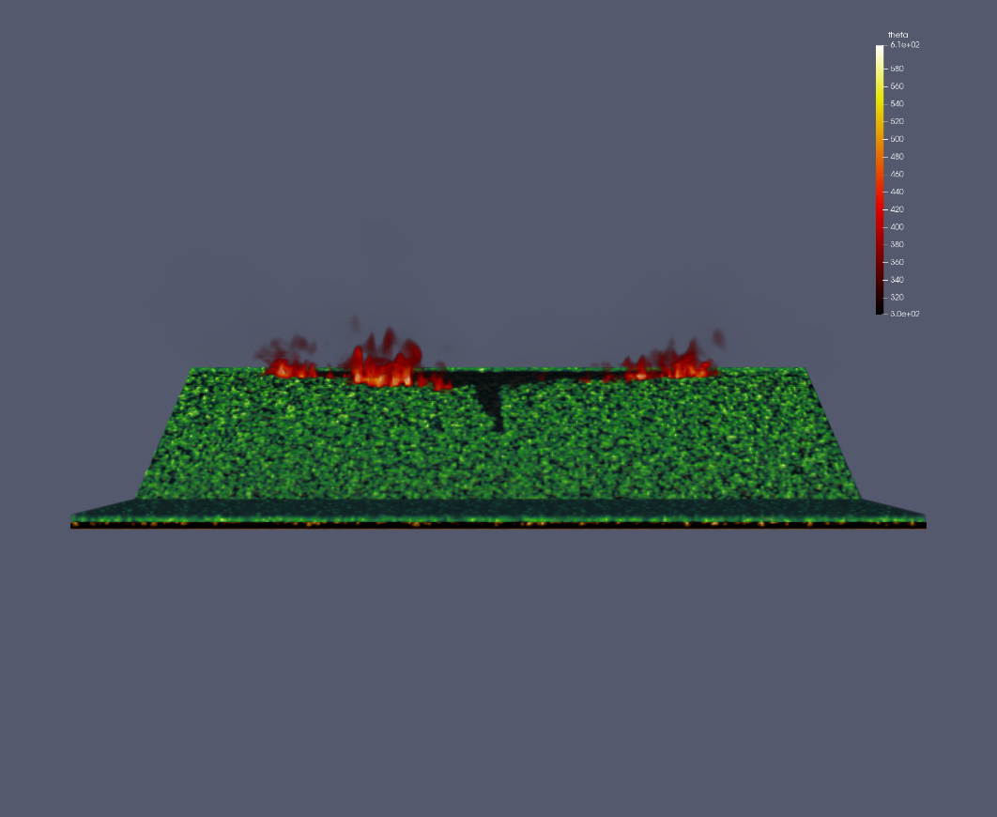
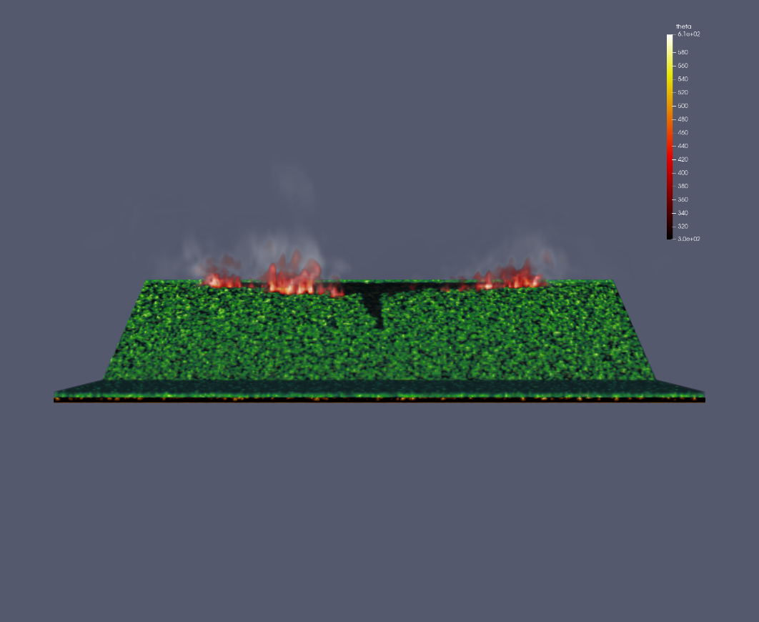
Milestone Presentation
Results
Fire, Watervapor
Fire
Fire + Watervapor

Slide 6
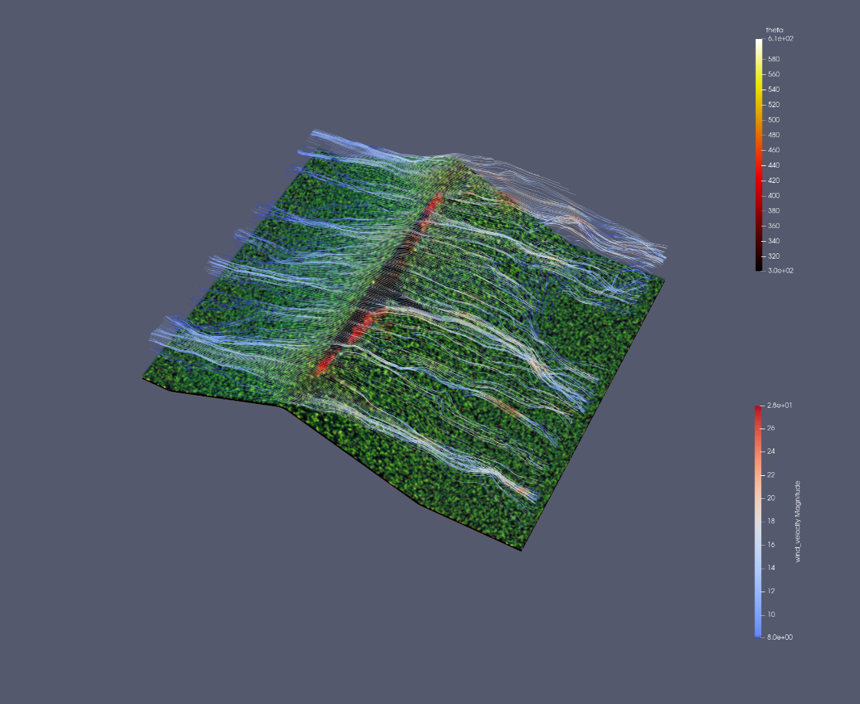
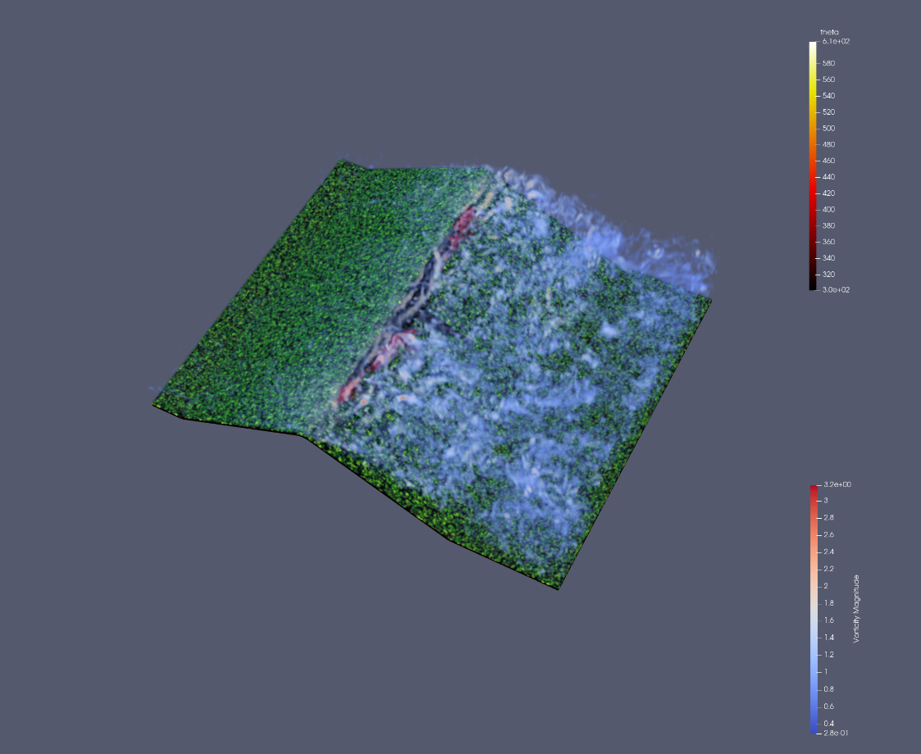
Milestone Presentation
Results
Velocity Field’s Streamlines
Vorticity Field

Slide 7
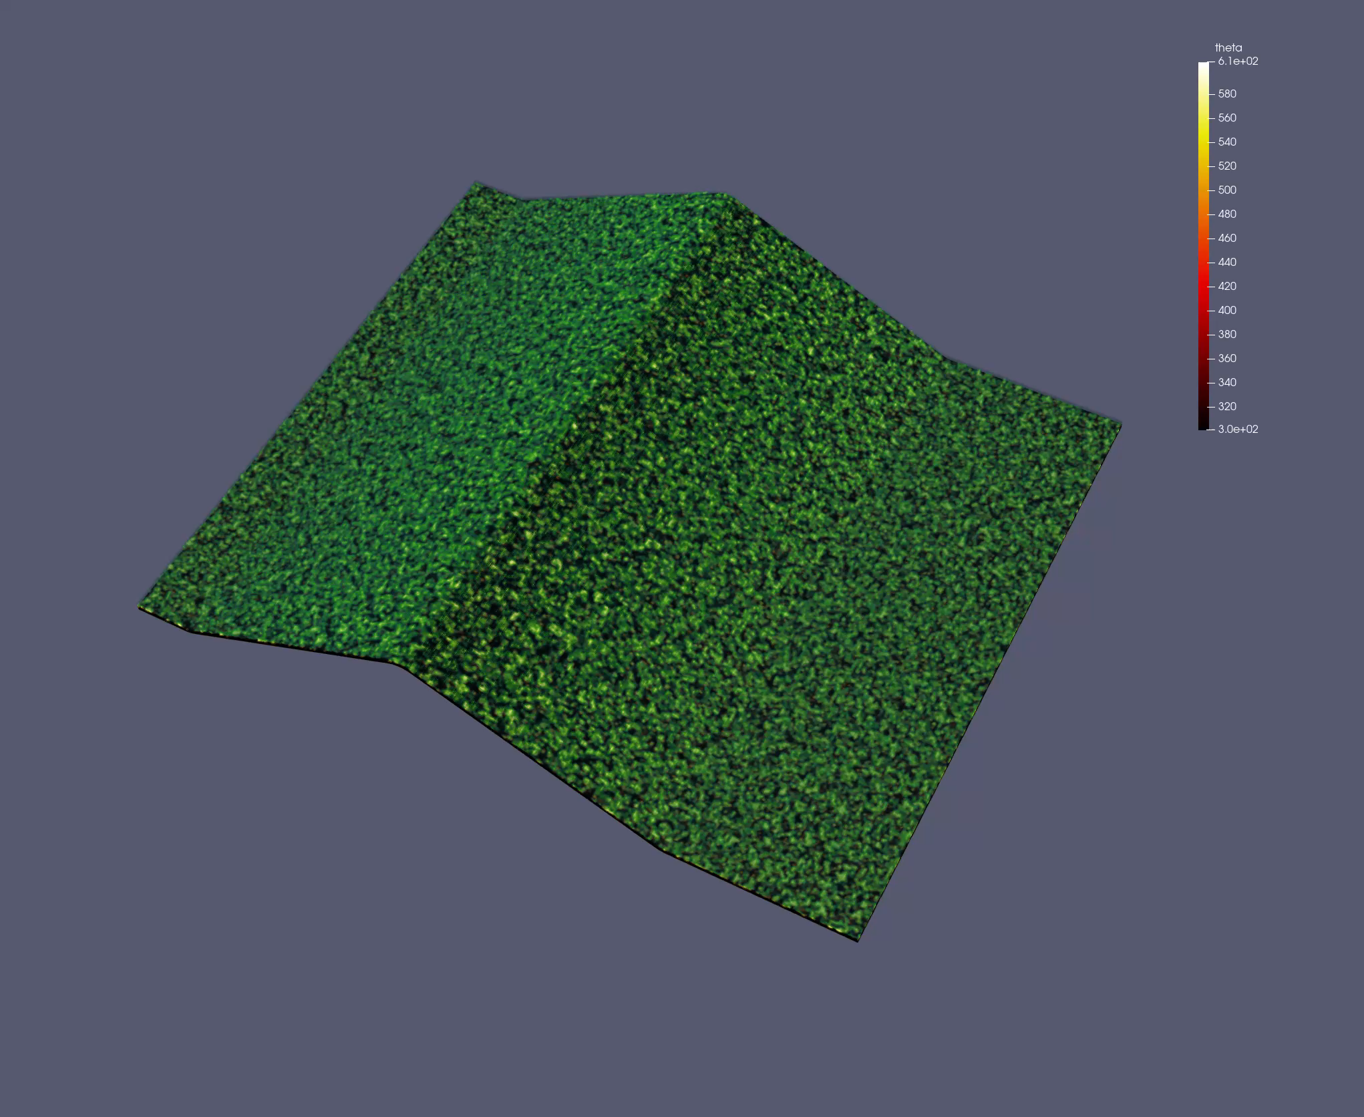
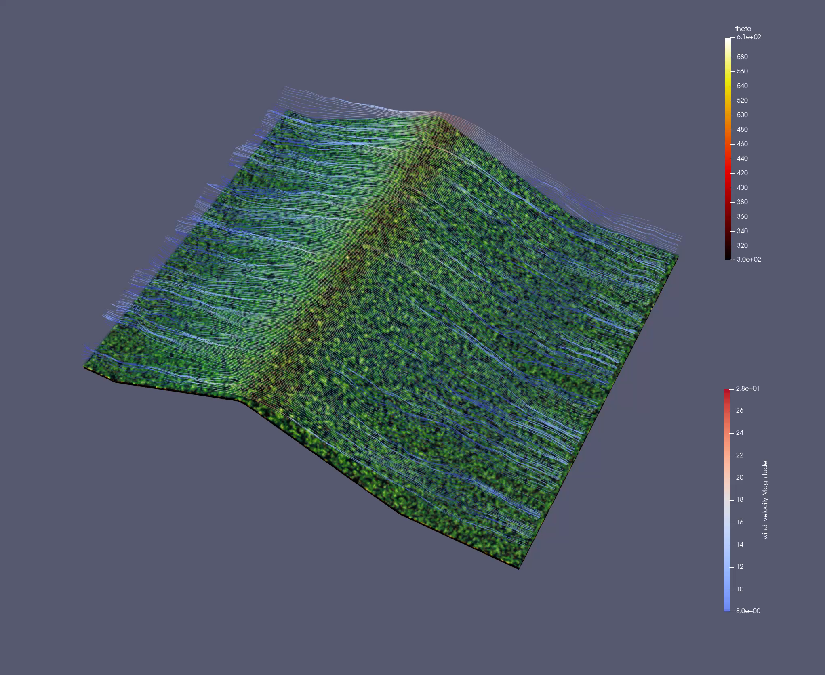
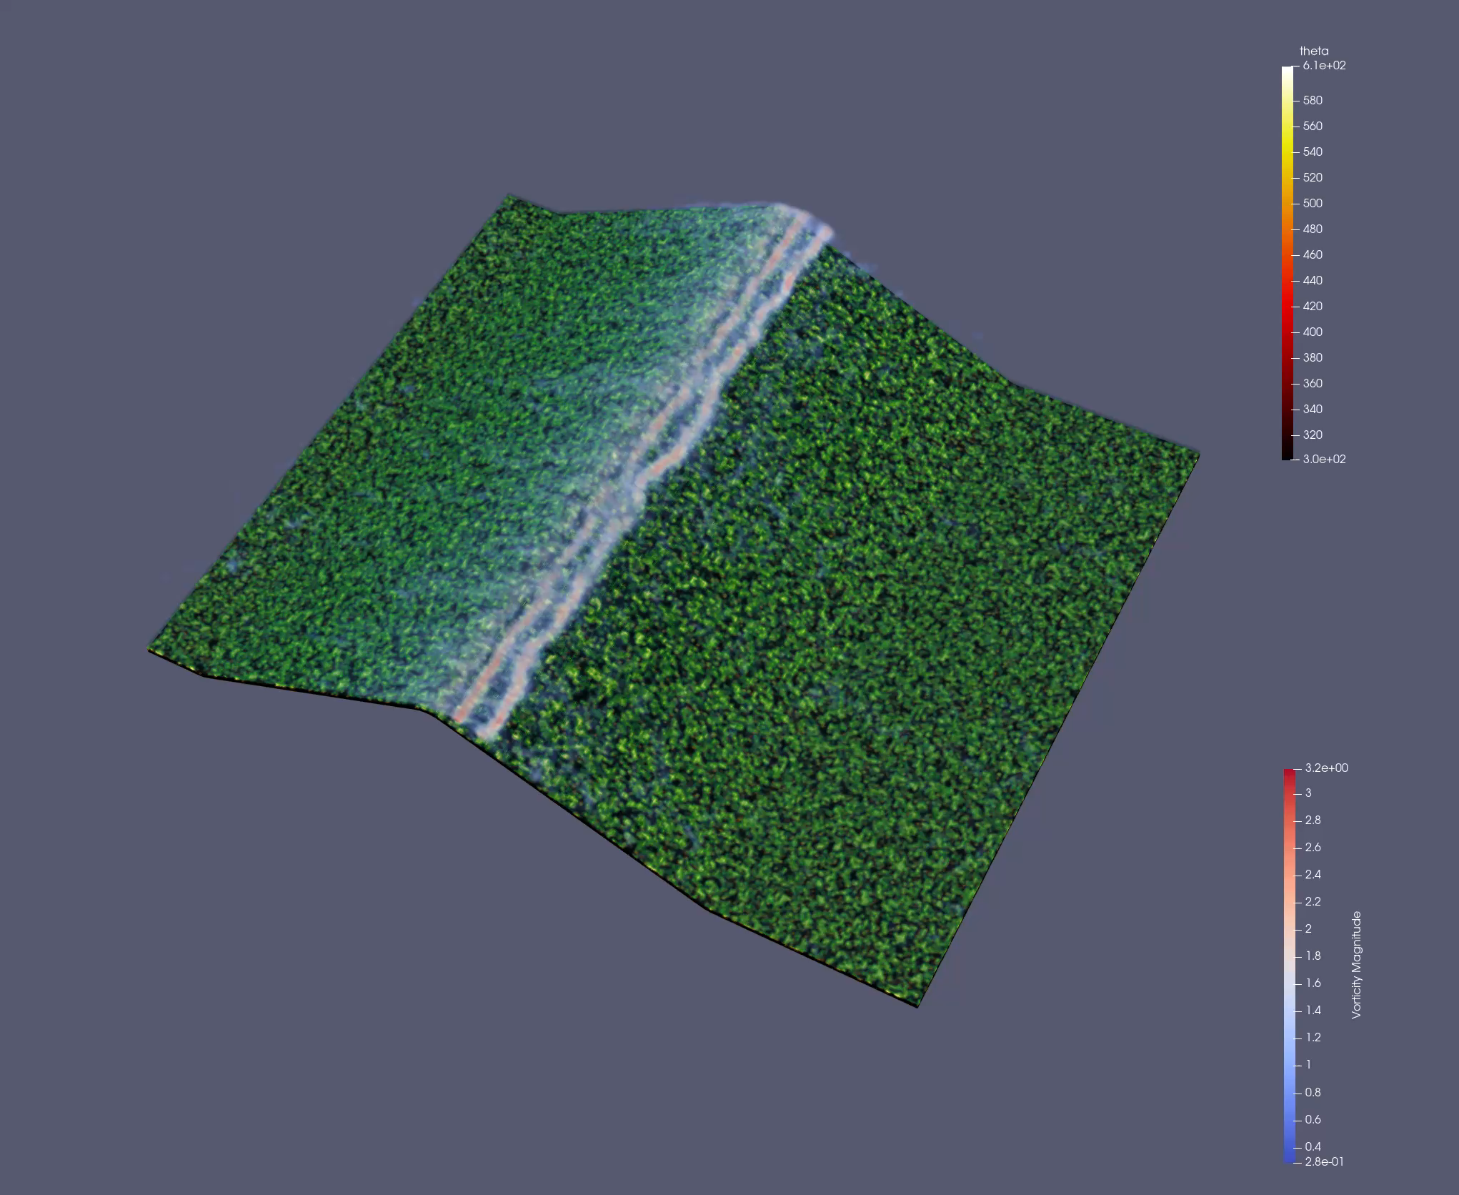
Milestone Presentation
Results
Assemble everything: just fire, with streamlines, and with vorticity fields

Slide 8
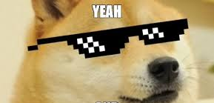
Milestone Presentation
Problems / Challenges
Which challenges have you faced so far?
Simplify and keep those elements that are most useful for the visualization goal. Too much information will mess up the scene. For e.g., better to remove vorticity field.
Paraview and VTK may have a big difference in form when implementing the same function.
Is there anything you are currently stuck with?
Analyze the causes of VLS from visualization results.
Does the team work well together?

Slide 9
Milestone Presentation
Timeline
What do you want to achieve by the final presentation?
Isosurfaces: more precise contours of fire, decided by oxygen level and fire-induced heat.
Quantitative Analysis: on how terrain and vorticity influence the VLS behavior.
VTK Implementation.
Make a sketch of the remaining timeline.
Isosurfaces + full animation: 1 week.
Implementing in VTK + Analysis: 1-2 weeks.
Report and final presentation slides: < 1 week.
If you are behind schedule: which items do you prioritize and what might be left out in the end?

